Slide 1
Linear independence
Linear Combination
A vector v is called a linear combination of the vectors u₁, u₂, …, u_{k} if
v = c₁u₁ + c₂u₂ + … + c_{k}u_{k},
where c₁, c₂, …, c_{k} are scalars.
Example 1
S = { (1, 3, 1), (0, 1, 2), (1, 0, −5)},
v₁ v₂ v₃
v₁ is a linear combination of v₂ and v₃ because
v₁ = 3v₂ + v₃ = 3(0, 1, 2) + (1, 0, −5)
= (1, 3, 1)

Slide 2
Linear independence
Definition:
A set of vectors {v₁, v₂, …, v_{k}} is called linearly dependent if there exist scalars c₁, c₂, …, c_{k} , not all zero, such that
c₁v₁ + c₂v₂ + … + c_{k}v_{k} = 0
The vectors are linearly independent. If the only set of scalars that satisfies the above equation is the set
c₁ = c₂ = … = c_{k} = 0
Examples (linearly dependent sets):
  The set S = {(1, 2), (3, 4)} is linearly dependent because
  −2(1, 2) + 1(2, 4) = (0, 0)
  The set S = {(1, 0), (0, 1), (−2, 5)} is linearly dependent because
  2(1, 0) −5(0, 1) + 1(−2, 5) = (0, 0)

Slide 3
Linear independence
Example (testing for linear independence)
Determine whether the following set of vectors is linearly dependent or linearly independent
S = { v₁ = (1, 2, 3), v₂ = (0, 1, 2), v₃ = (−2, 0, 1)}
Solution: c₁v₁ + c₂v₂ + c₃v₃ = 0
⇒ c₁(1, 2, 3) + c₂(0, 1, 2) + c₃(−2, 0, 1) = (0, 0, 0)
⇒ (c₁−2c₃, 2c₁+c₂, 3c₁+2c₂ +c₃) = (0, 0, 0)
⇒ c₁ = c₂ = c₃ = 0
Therefore, S is linearly independent.

Slide 4
Linear independence:
properties
Theorem 1:
A set of vectors is linearly dependent if and only if one of the vectors is a linear combination of the others.
Theorem 2: Any set of vectors containing the zero vector is linearly dependent.
Theorem 4:
If a set of vectors is linearly independent, then any subset of these vectors is also linearly independent.
Theorem 5:
If a set of vectors is linearly dependent, then any larger set, containing this set, is also linearly dependent.

Slide 5
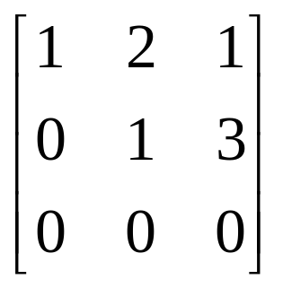
Rank
Definition 1:
The row rank of a matrix is the maximum number of linearly independent vectors that can be formed from the rows of that matrix, considering each row as a separate vector.
Analogically, the column rank of a matrix is the maximum number of linearly independent columns, considering each column as a separate vector.
Theorem 1:
The row-rank of a row-reduced matrix is the number of nonzero rows in that matrix.
Example: The rank of is 2.

Slide 6
Rank
Theorem 2:
The row rank of and the column rank of a matrix are equal.
For any matrix A, that common number is called the rank of A and denoted by r(A).
Theorem 3:
If B is obtained from A by an elementary row (or column) operation, then r(B) = r(A) .
Theorems 1-3 suggest a useful procedure for determining the rank of any matrix:
- Use elementary operations to transform the given matrix to row-reduced form;
- Count the number of nonzero rows.

Slide 7
Theory of Solutions
Theorem 1:
The system Ax = b is consistent if and only if r(A) = r(A^{b}).
Theorem 2:
If the system Ax = b is consistent and r(A) = k . Then the solutions are expressible in terms of arbitrary n - k unknowns (where n represents the number of unknowns in the system).
For a homogenous system Ax = 0, the right-hand side b=0. Thus, r(A) = r(A^{b}) and a homogenous system is always consistent. Namely, x₁ = x₂ = … = x_{n} = 0 is always a trivial solution for a homogenous system.
Theorem 3: Homogenous system Ax = 0 will admit nontrivial solutions if and only if r(A) ≠ n

Slide 8
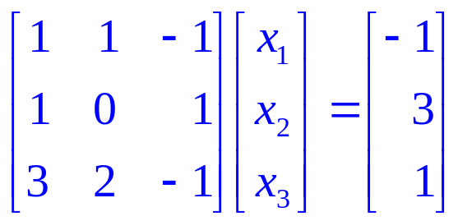
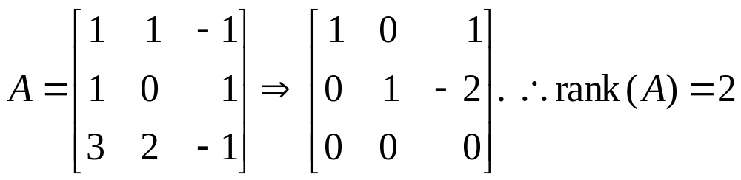
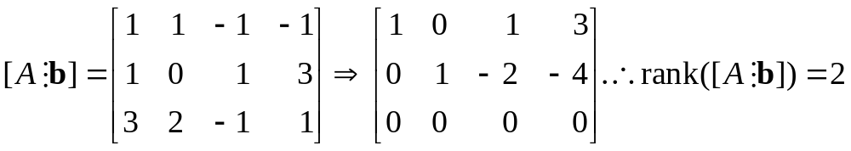
Theory of Solutions: example
The rank of A is equal to the rank of [A  b]. Hence the system is consistent. The solutions are expressible in terms of 3-2=1 arbitrary unknowns.

